Slide 1
Evaluation and improvement of a dual-channel method for the detection and quantification of high-temperature events on FireBIRD data
Penghua Li, October 04, 2017

Slide 2
Contents
Introduction of MITIP, an atmospheric correction and image processing method
Short description of MITIP
Data preparation and pre-processing
Outcomes of the MITIP
Validation and improvement of the MITIP
Results comparison with MODIS SST and calibration
Transferability test (SST)
Results comparison with MODIS LST and calibration
Transferability test (LST)
Analysis of high-temperature events
High-temperature events
Comparison with the results of Zhukov’s algorithm
Conclusion and outlook

Slide 3
1. Introduction of MITIP, an atmospheric correction and image processing method
The MITIP method is an atmospheric correction and image processing method developed by Dr.Rudolf at DLR, which is used for processing the thermal remote sensing imageries of the FireBIRD satellite.
MITIP firstly performs atmospheric corrections for the TET-1 imagery based on the water vapor column and elevation to get the ground surface radiance and temperature. Afterwards, a dual channel method is used to detect and characterize sub-pixel temperatures of hot pixels.

Slide 4
1. 2 Data preparation and pre-processing
Required input for MITIP:
TET-1 scene with two bands: MIR as the first band, TIR as the second band;
Water vapor file. Here we use MODIS water vapor products;
Digital Elevation Models (DEM). ASTER Global Elevation map is used;
Emissivity maps. Here we use the ASTER Global Emissivity Database;
All the above data is downloaded from the NASA’s websites. Most of them need to be converted to the GeoTIFF format firstly. According to the requirement of the MITIP, the input data should be 1) overlapped and 2) share the same numbers of rows and columns and 3) have same pixel size.
Here Python and GDAL are used to do the pre-processng.
All input files and converted to the GeoTIFF format and reprojected into an appropriate UTM zone;
All input files are resampling to pixel size 150 * 150;
The TET-1 scene is used as mask to clip other imageries to ensure they are of same size.

Slide 5
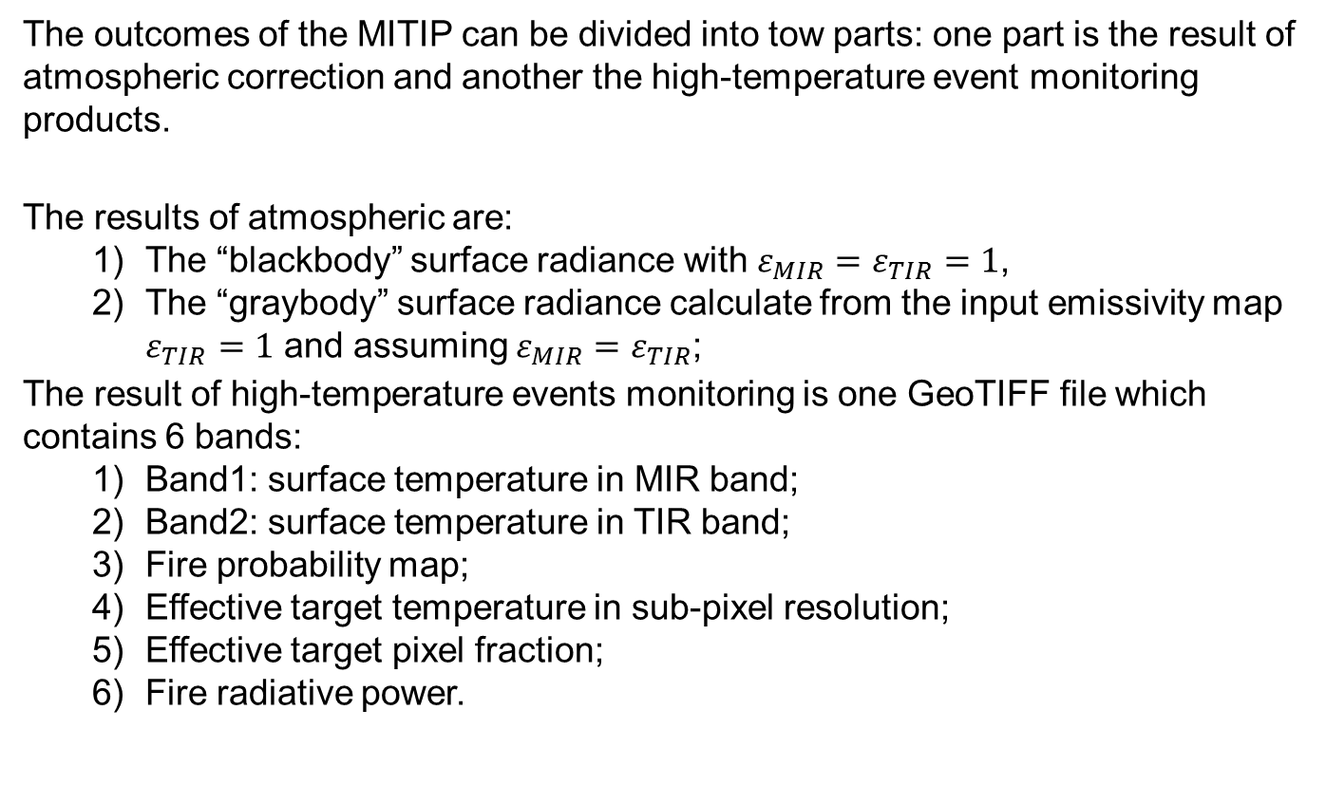
1. 3 Outcomes of the MITIP
The outcomes of the MITIP can be divided into tow parts: one part is the result of atmospheric correction and another the high-temperature event monitoring products.
The results of atmospheric are:
The “blackbody” surface radiance with $ε_{MIR}=ε_{TIR}=1$,
The “graybody” surface radiance calculate from the input emissivity map $ε_{TIR}=1$ and assuming $ε_{MIR}=ε_{TIR}$;
The result of high-temperature events monitoring is one GeoTIFF file which contains 6 bands:
Band1: surface temperature in MIR band;
Band2: surface temperature in TIR band;
Fire probability map;
Effective target temperature in sub-pixel resolution;
Effective target pixel fraction;
Fire radiative power.

Slide 6
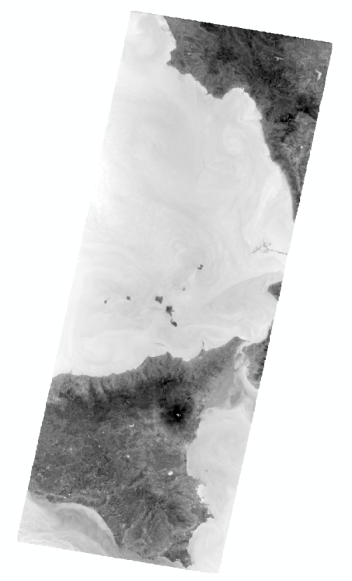
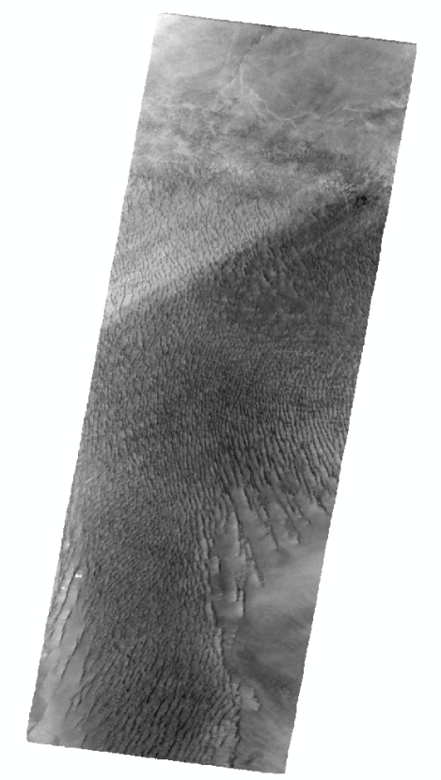
2. Validation and improvement of the MITIP
To see whether the temperature results derived from the MITIP is reliable or not, firstly we compare them with MODIS temperature products, namely MODIS Sea Surface Temperature (SST) and MODIS Land Surface Temperature (LST), to see its performance under normal temperature environments.
Here we select two test sites whose imageries mainly covered by sea (Etna) and homogeneous landscape (Libya) respectively.
Etna:
Libya-1:

Slide 7
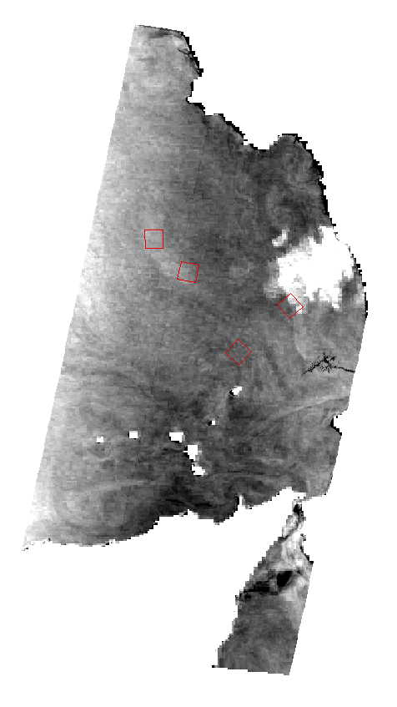
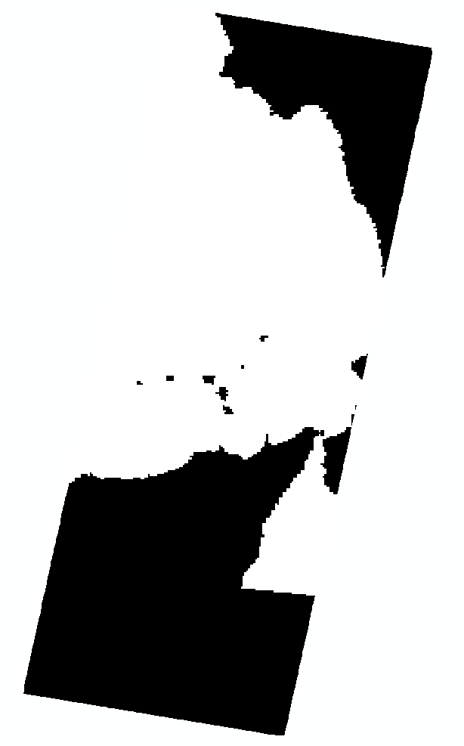
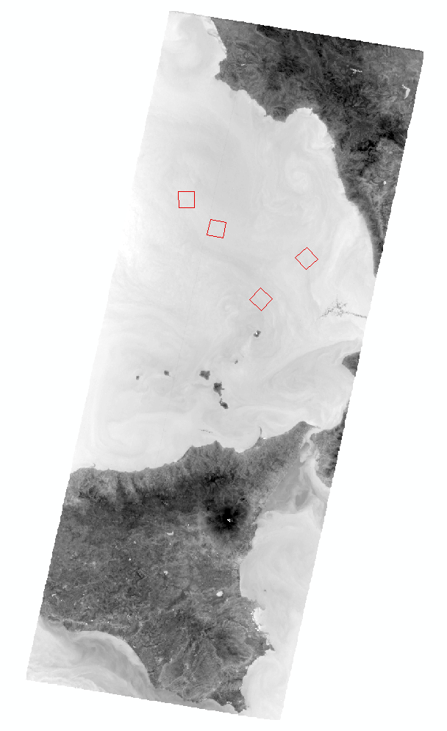
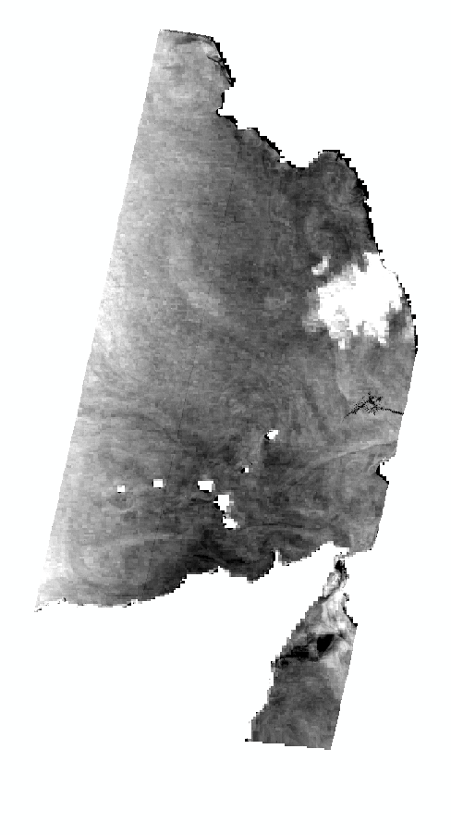
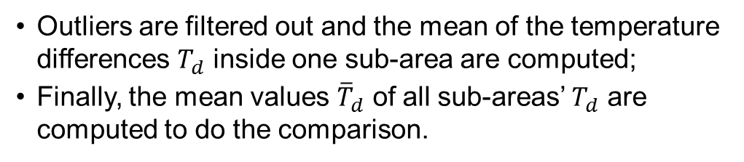
2. Validation and improvement of the MITIP
The comparisons are done as follows (Etna as example):
The MODIS temperature products are reprojected into the same projection as TET-1 imagery, then resampled into same pixel size and clip into the same size as TET-1 imagery.
The differences of the temperature between the MITIP temperature results and MODIS temperature products are computed through the whole imagery.
For each test site, several (3 – 5) sub-areas which are cloud-free and homogeneous inside for all scenes are selected.
Outliers are filtered out and the mean of the temperature differences $T_{d}$ inside one sub-area are computed;
Finally, the mean values ${\overline{T}}_{d}$ of all sub-areas’ $T_{d}$ are computed to do the comparison.

Slide 8
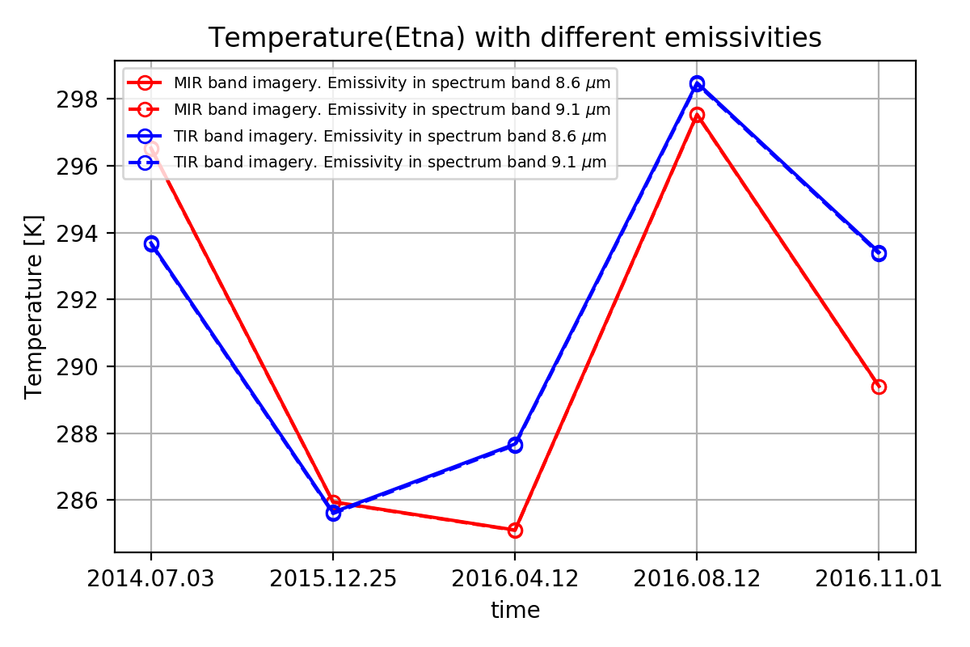
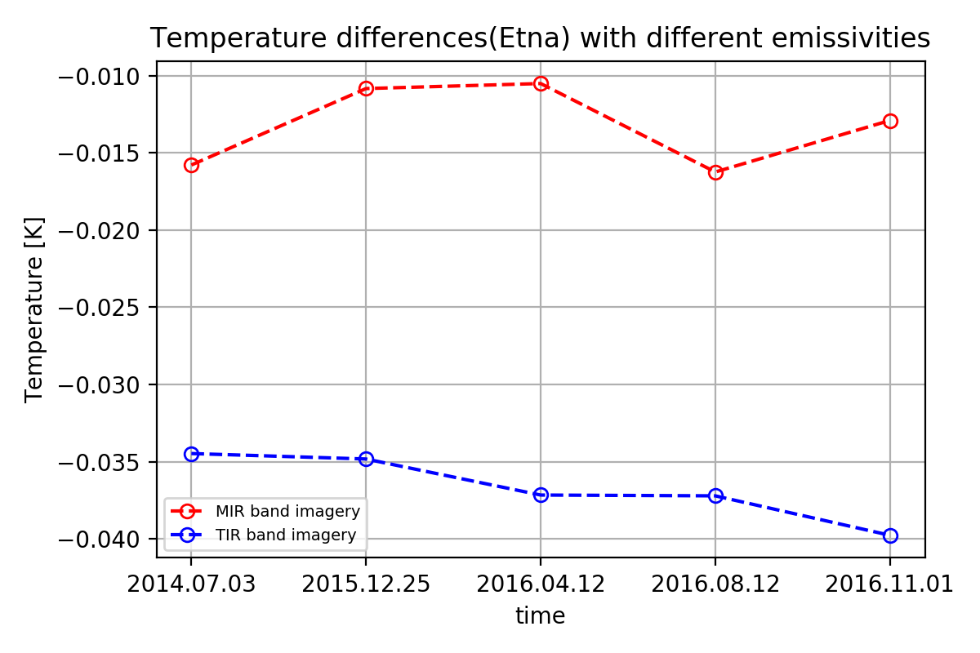
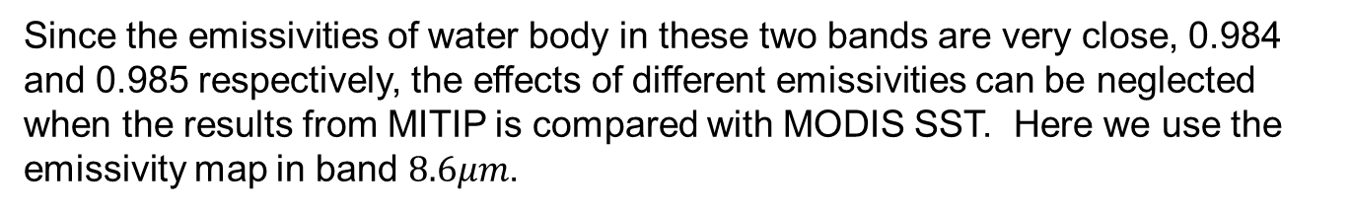
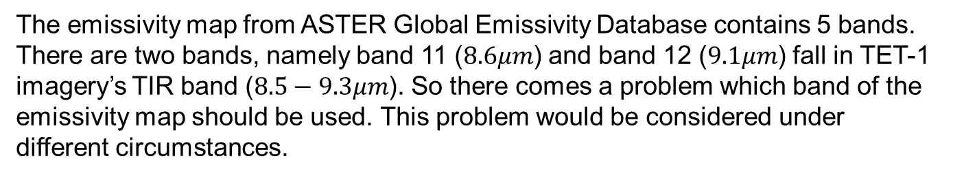
2.1 Results comparison with MODIS SST and calibration
The emissivity map from ASTER Global Emissivity Database contains 5 bands. There are two bands, namely band 11 ($8.6μm$) and band 12 ($9.1μm$) fall in TET-1 imagery’s TIR band ($8.5−9.3μm$). So there comes a problem which band of the emissivity map should be used. This problem would be considered under different circumstances.
Since the emissivities of water body in these two bands are very close, 0.984 and 0.985 respectively, the effects of different emissivities can be neglected when the results from MITIP is compared with MODIS SST. Here we use the emissivity map in band $8.6μm$.

Slide 9
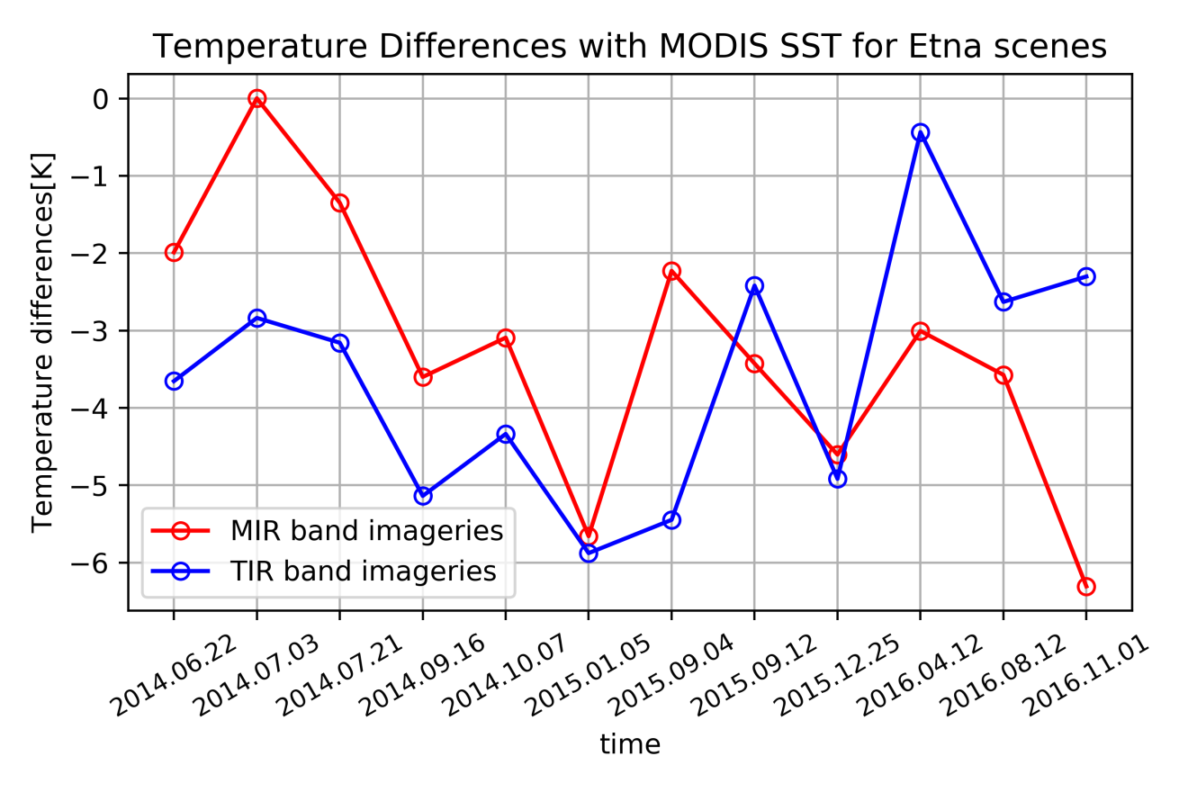
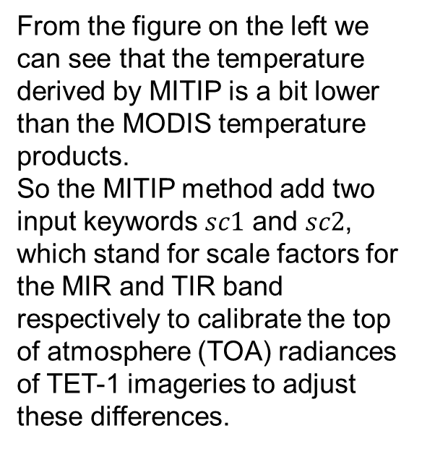
2.1 Results comparison with MODIS SST and calibration
Firstly, the temperature results from MITIP are compared with MODIS SST.
From the figure on the left we can see that the temperature derived by MITIP is a bit lower than the MODIS temperature products.
So the MITIP method add two input keywords $sc1$ and $sc2$, which stand for scale factors for the MIR and TIR band respectively to calibrate the top of atmosphere (TOA) radiances of TET-1 imageries to adjust these differences.

Slide 10
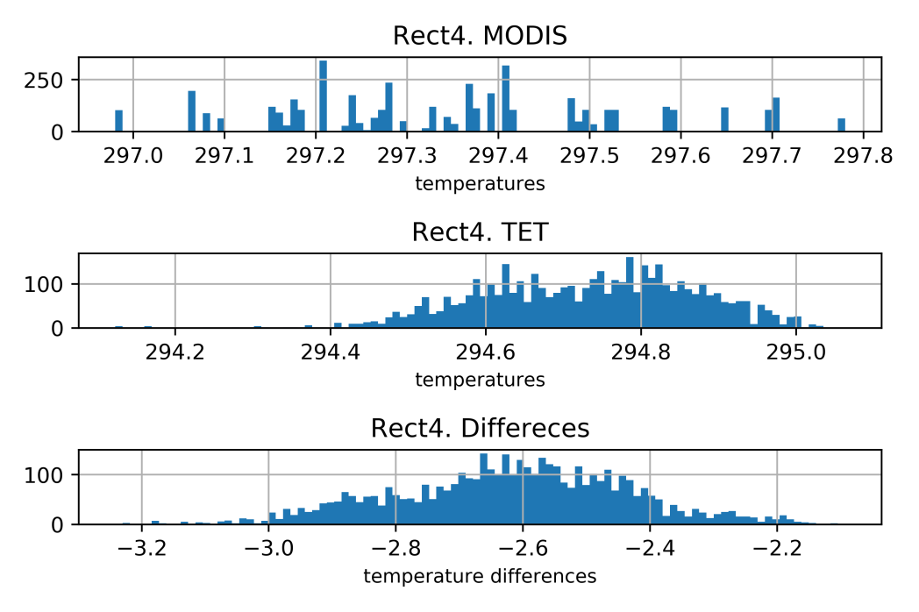
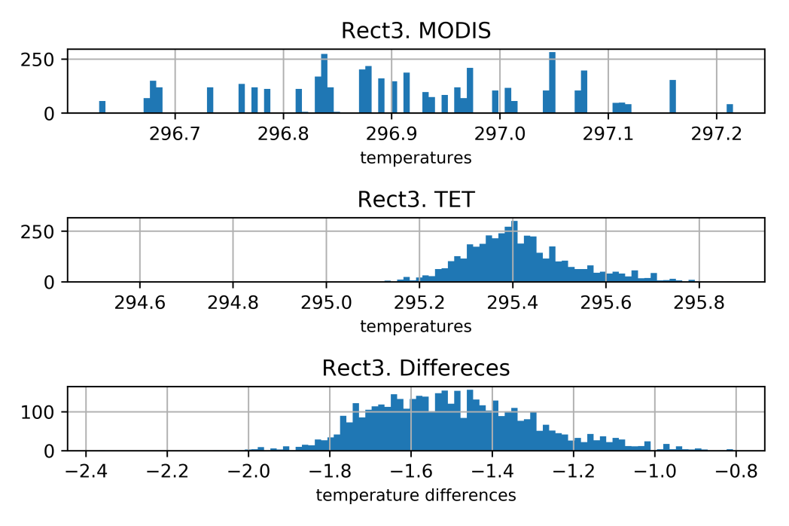
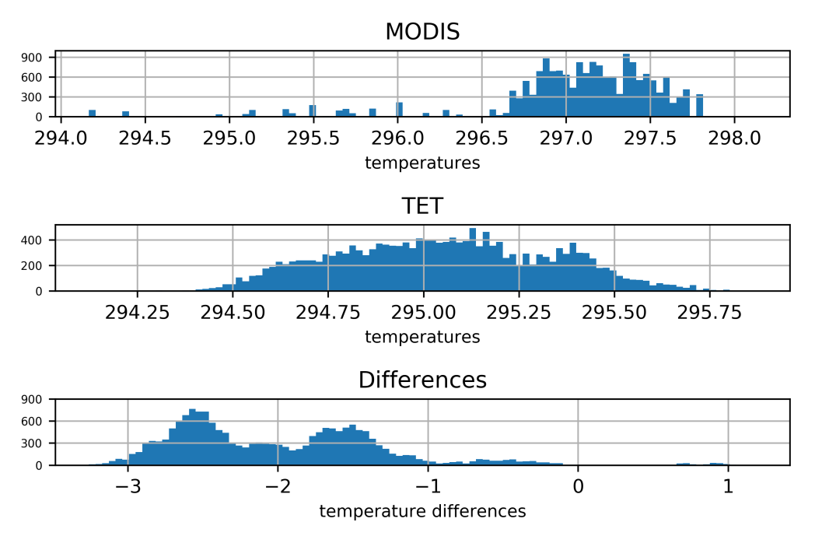
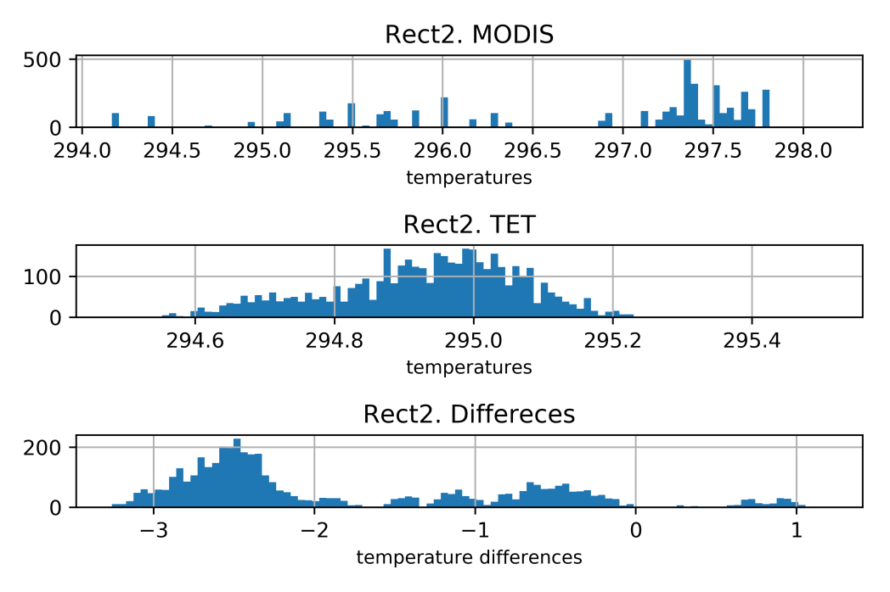
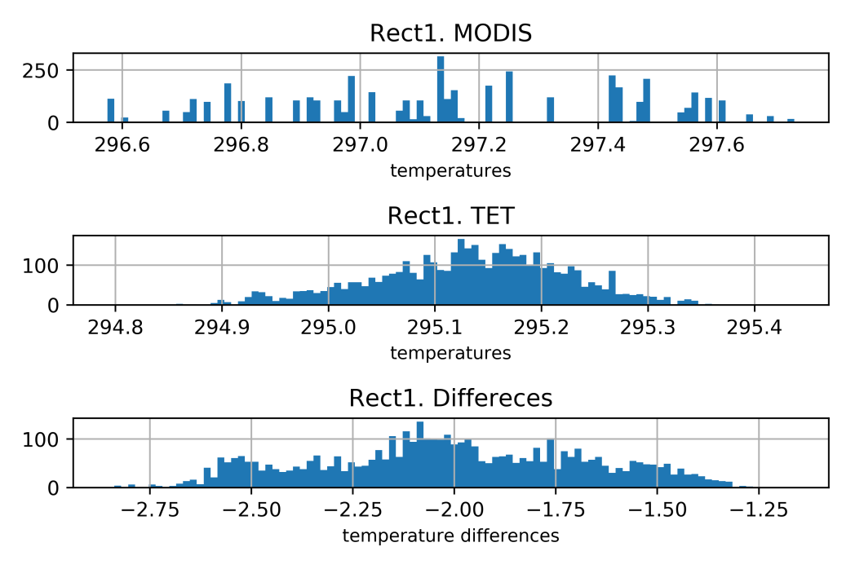
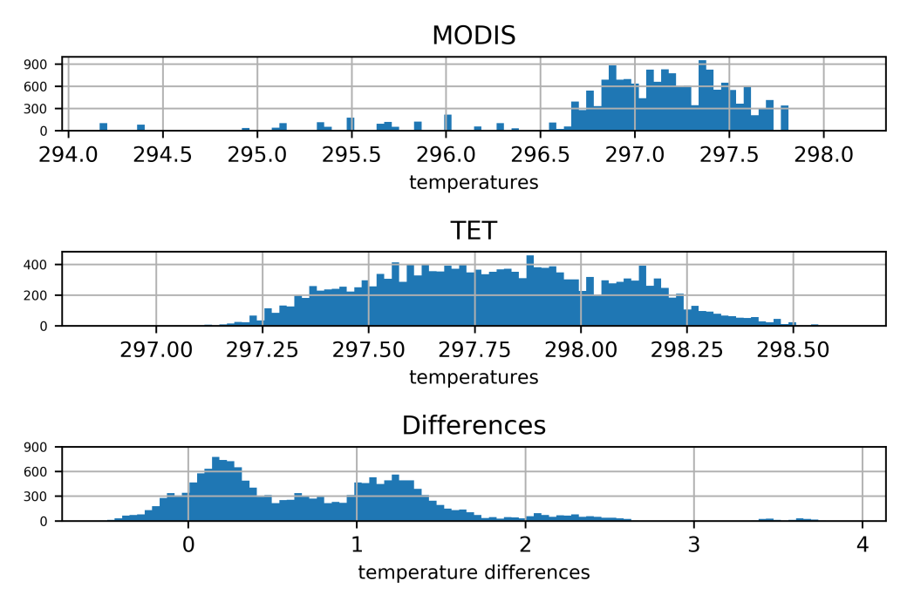


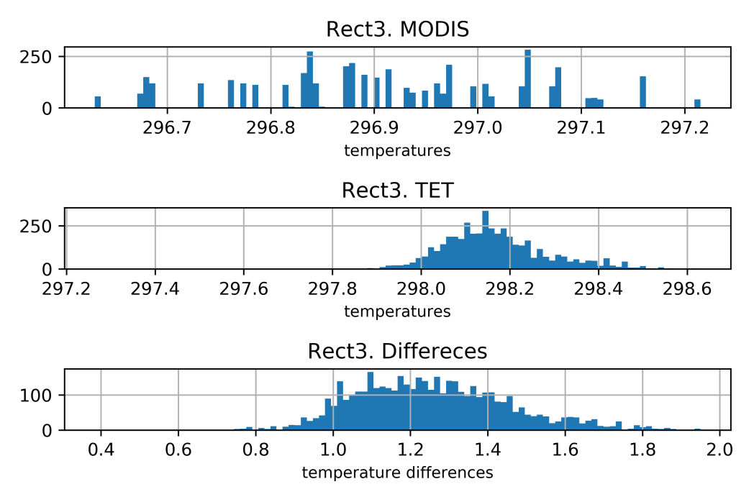
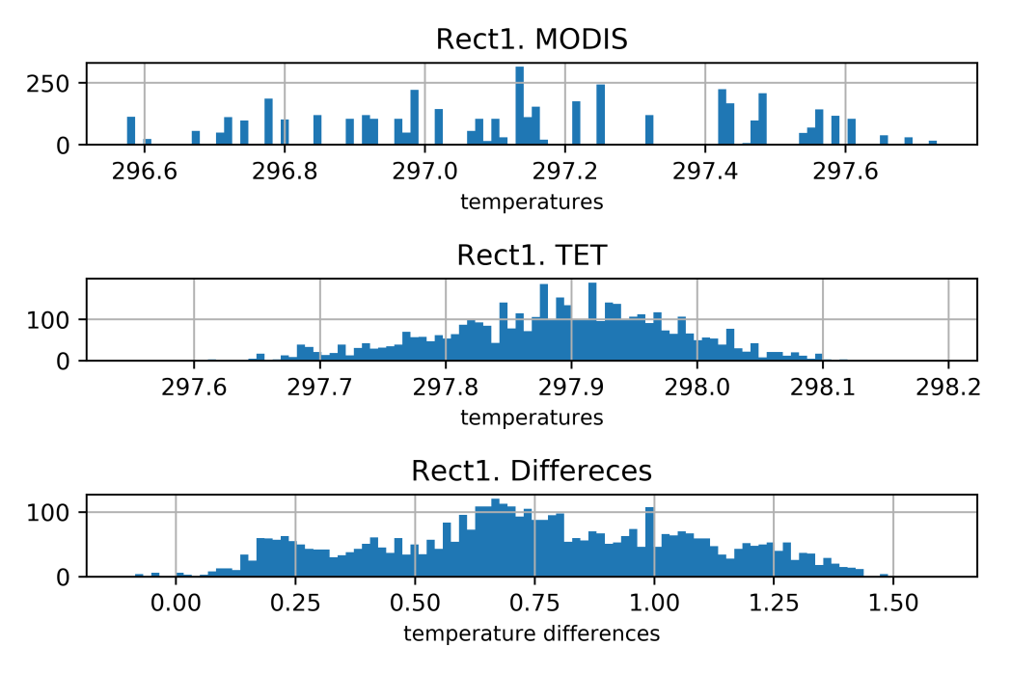
2.1 Results comparison with MODIS SST and calibration
Since the temperature derived by MITIP is a bit lower than the MODIS temperature products, we need to increase the TOA radiances. Here we selected five scale factors, namely 1.00 (original TOA radiances), 1.05 (increase the TOA radiances by 5%), 1.10, 1.15, 1.20, for each band.
Scale factor 1.00
To see how the scale factor will affect the results of the MITIP, the histograms of the sub-areas in the TET-1 imagery with different scale factors are investigated.
Firstly, we use the scene of 2014.06.22 and scale factor 1.00 and 1.10 as example.
Scale factor 1.10

Slide 11
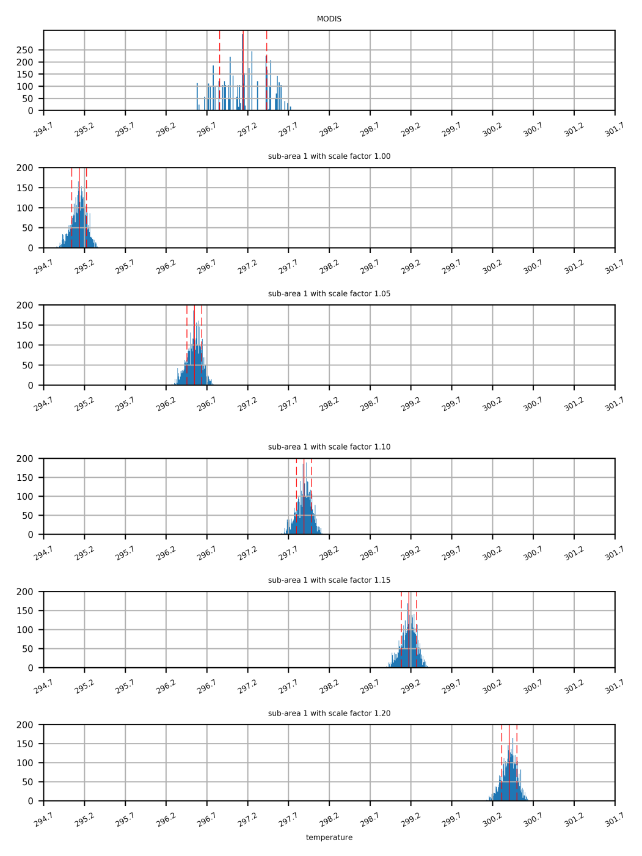
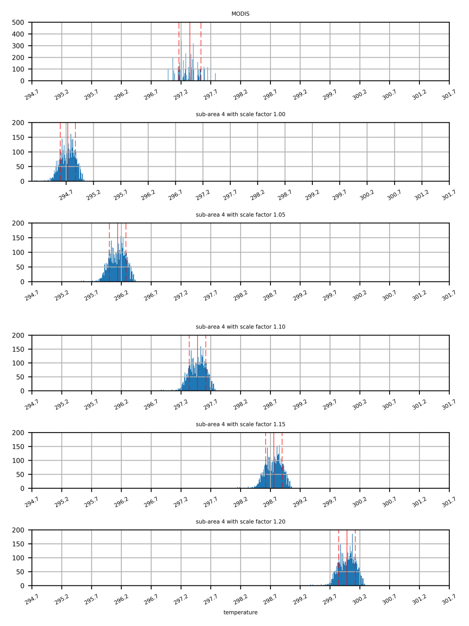
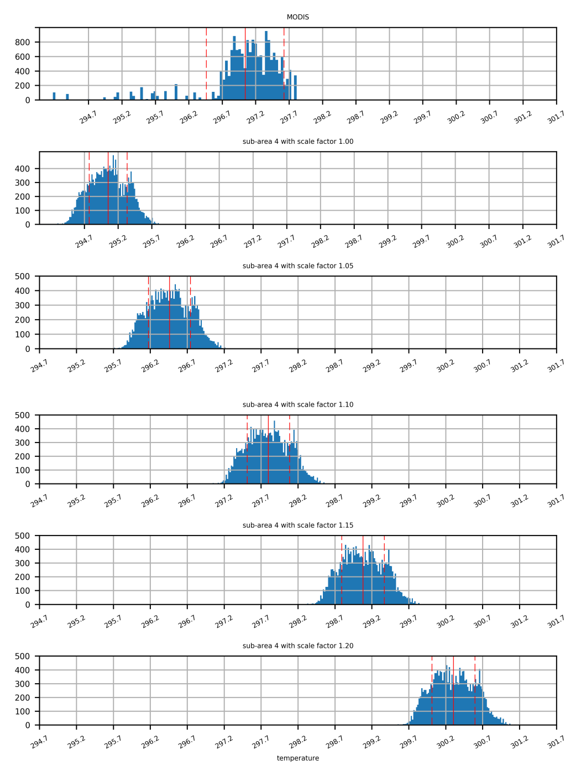
2.1 Results comparison with MODIS SST and calibration
To make the shift more clearly, the histograms of sub-area 1 and sub-area 4 with all the five scale factor are shown on the right.
But we are not consider individual sub-area merely. Since the mean value over all sub-areas are used, the histogram of all pixels inside the 4 sub-areas are plotted and shown on the right.
Sub-area 1
Sub-area 4
Sub-area All

Slide 12
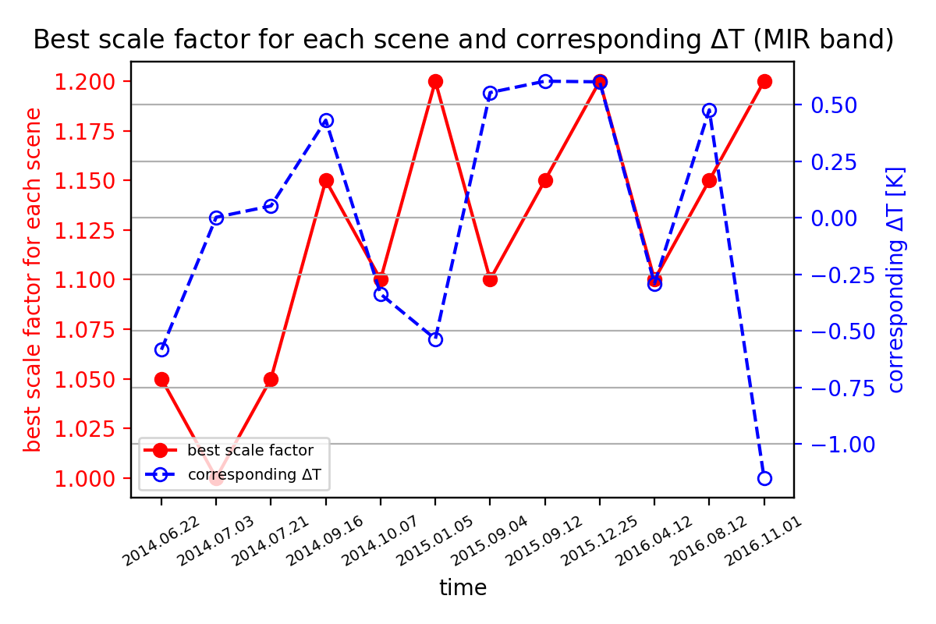
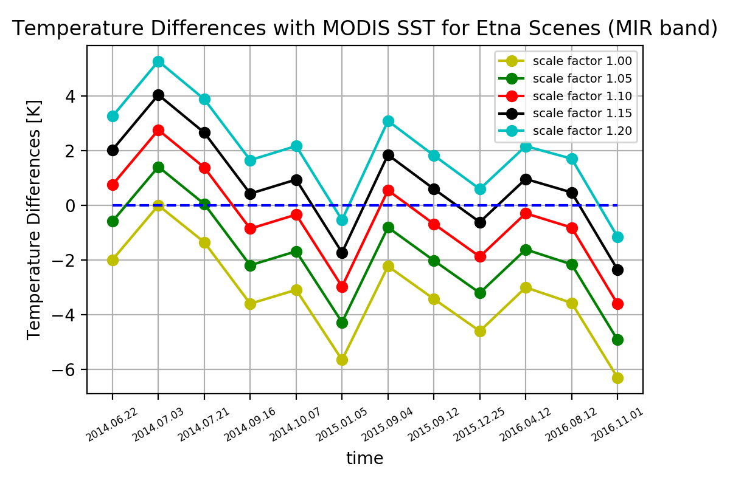
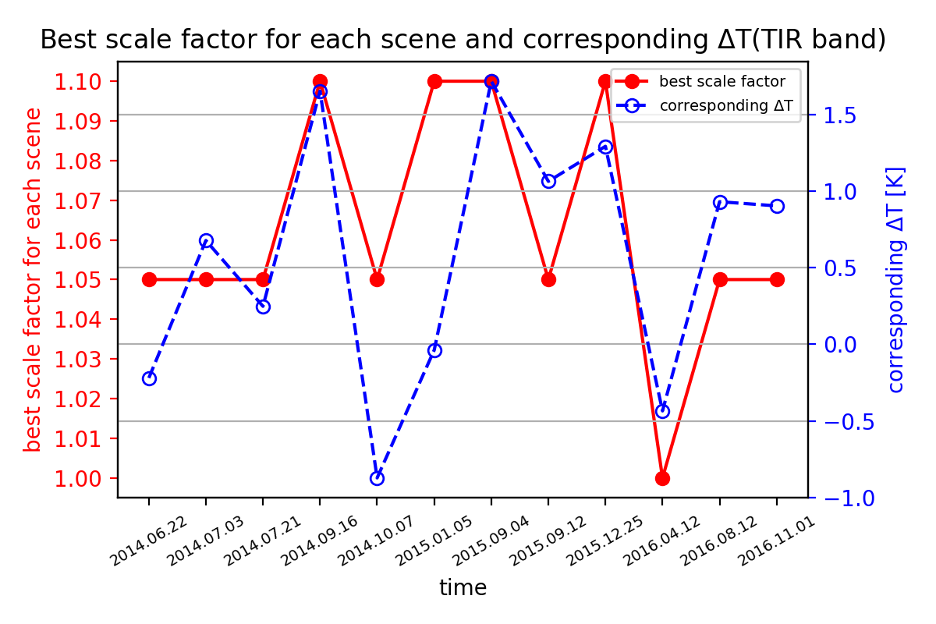
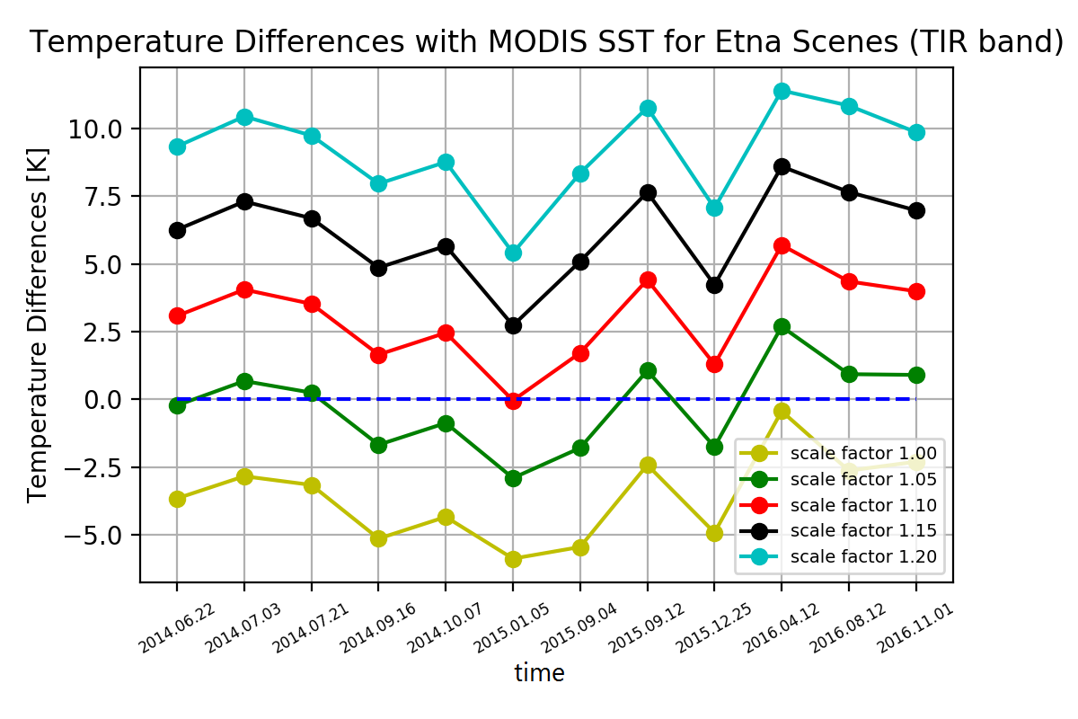
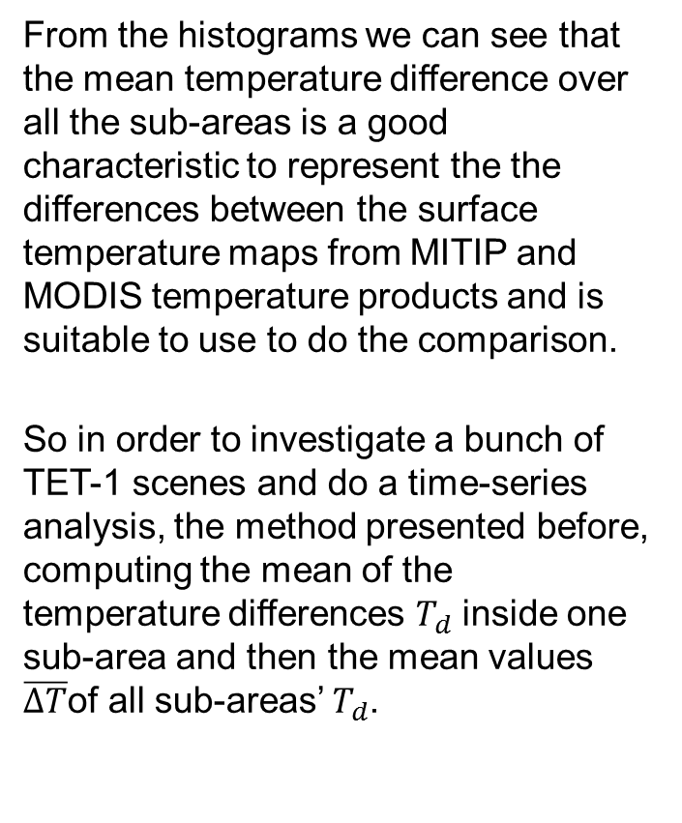
2.1 Results comparison with MODIS SST and calibration
From the histograms we can see that the mean temperature difference over all the sub-areas is a good characteristic to represent the the differences between the surface temperature maps from MITIP and MODIS temperature products and is suitable to use to do the comparison.
So in order to investigate a bunch of TET-1 scenes and do a time-series analysis, the method presented before, computing the mean of the temperature differences $T_{d}$ inside one sub-area and then the mean values $\overline{∆T}$of all sub-areas’ $T_{d}$.

Slide 13
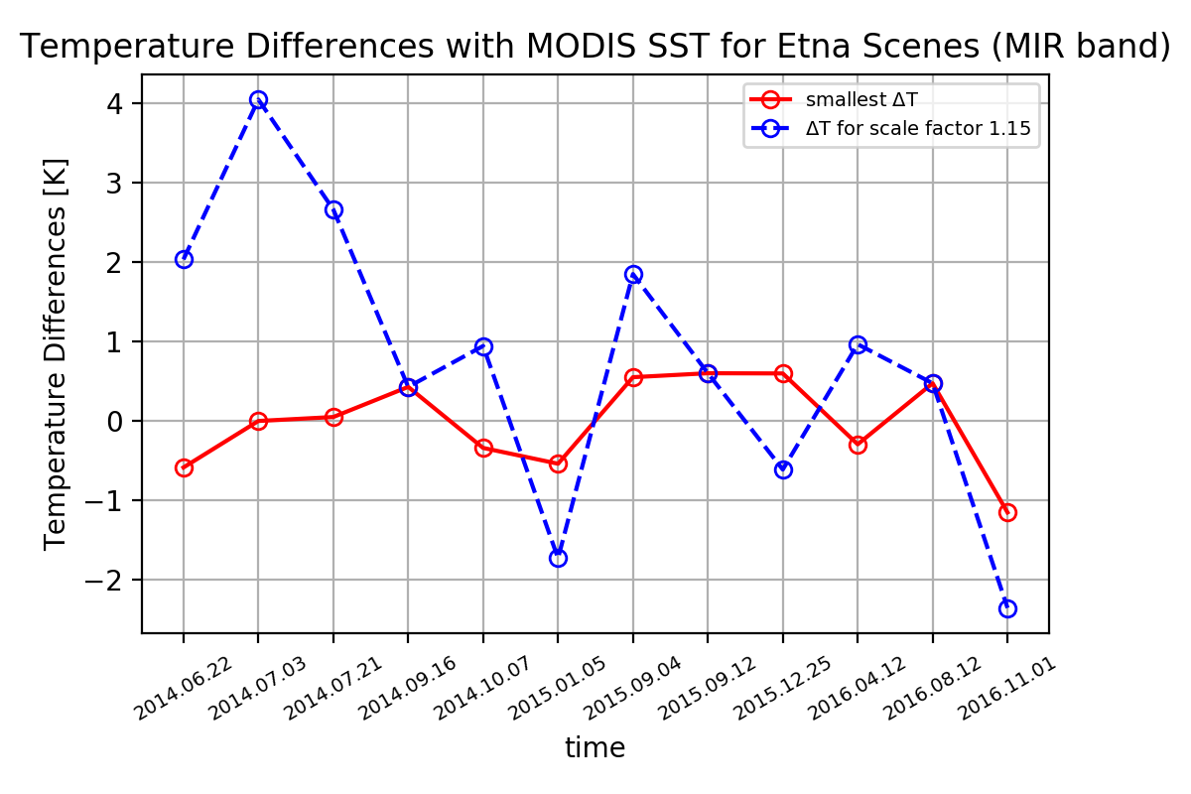
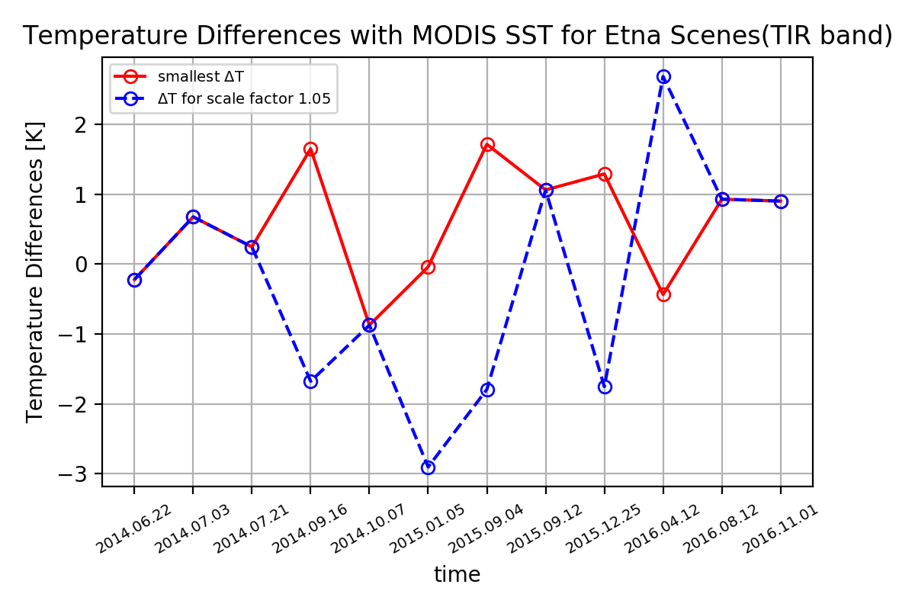

2.1 Results comparison with MODIS SST and calibration
The optimal scale factor for each band and its corresponding temperature difference $∆T$ is showed below.
According to the comparison results and analyses, the optimal scale factor for MIR band is chosen as 1.15 and for TIR band1.05.

Slide 14
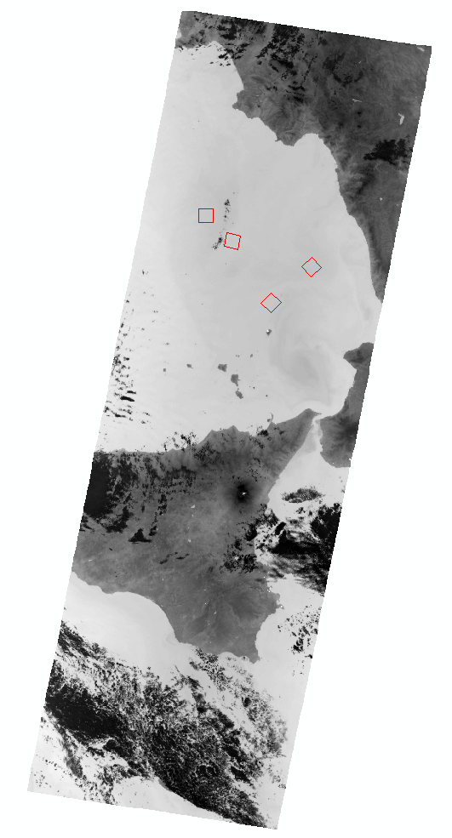
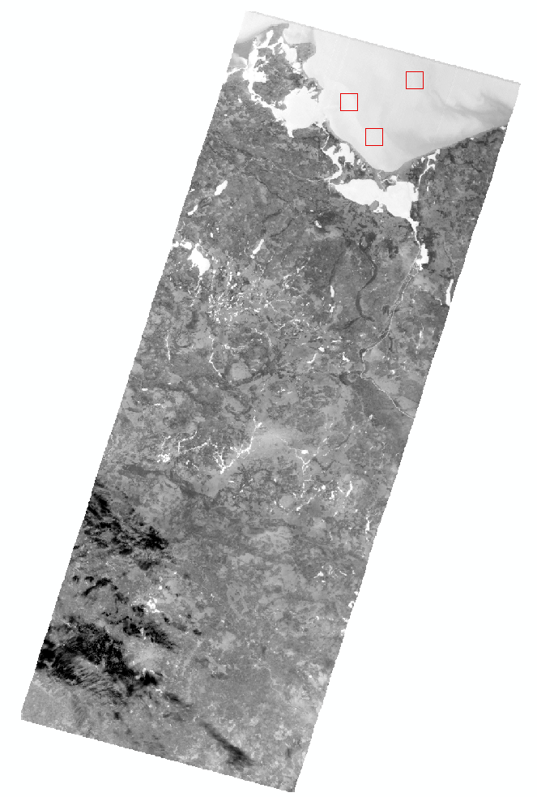
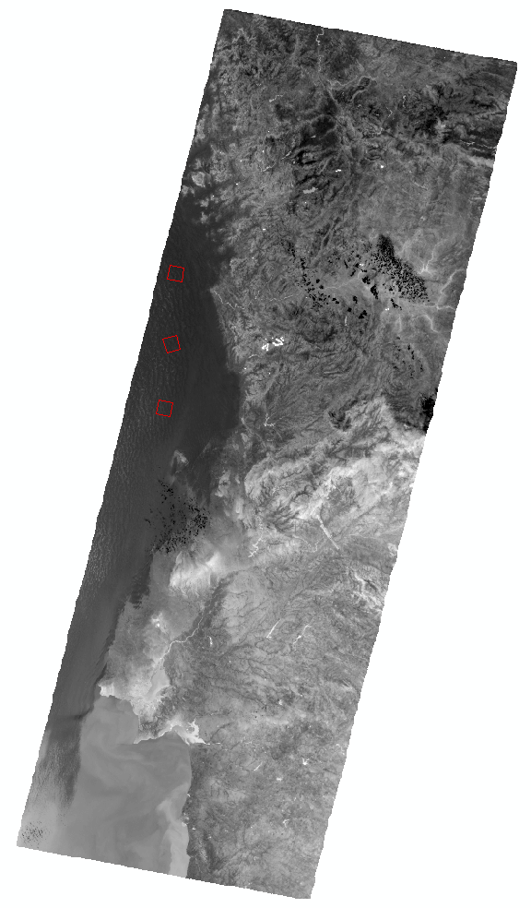
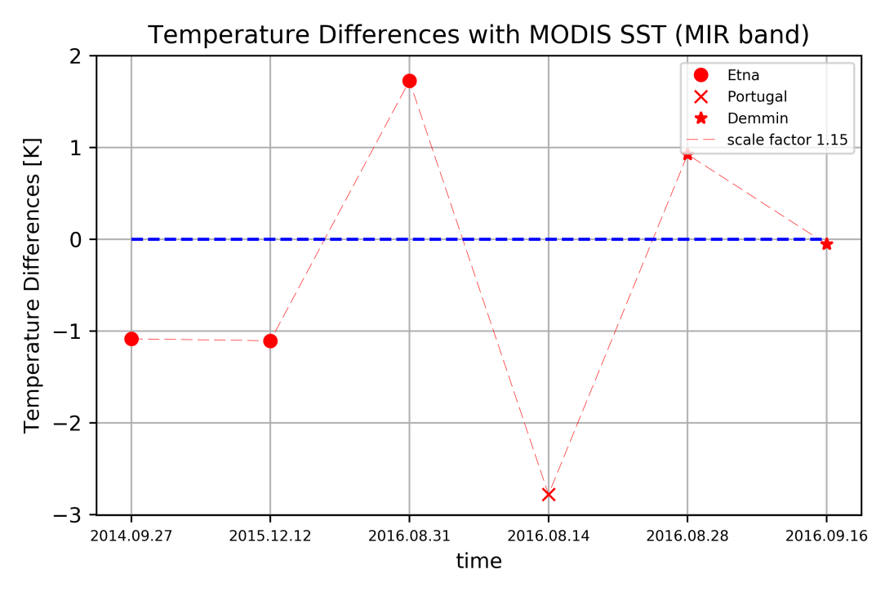
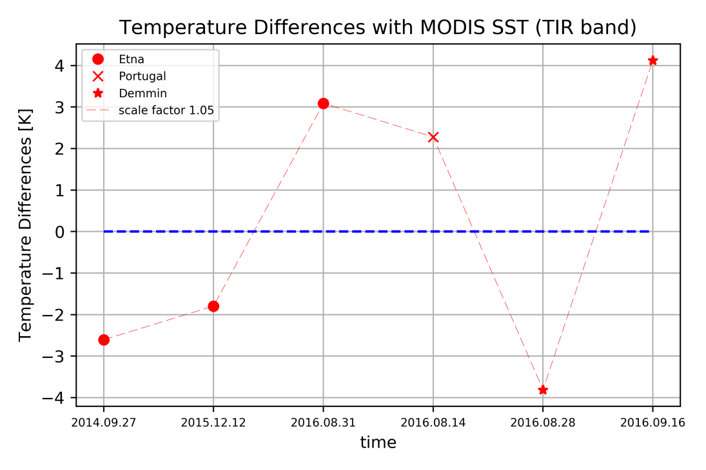
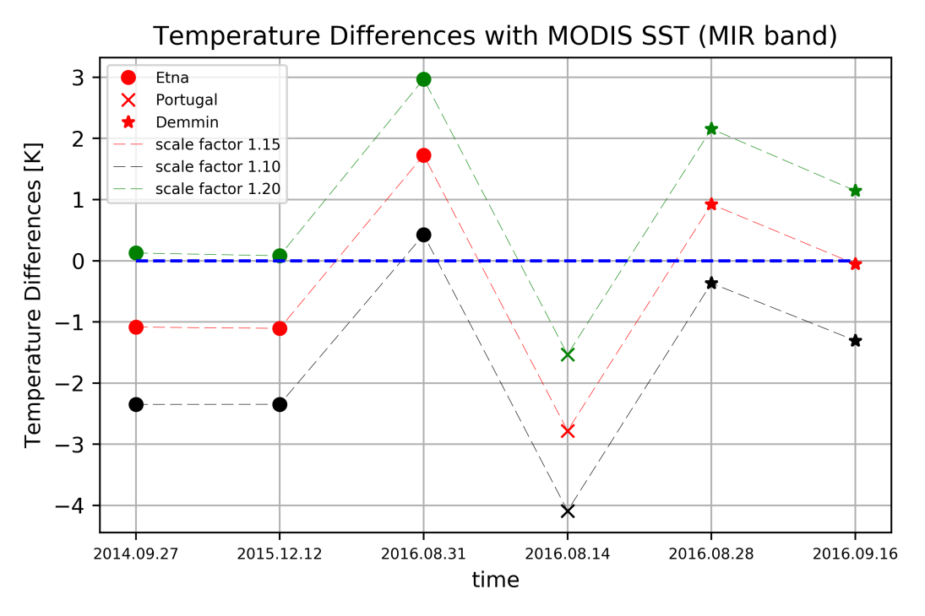
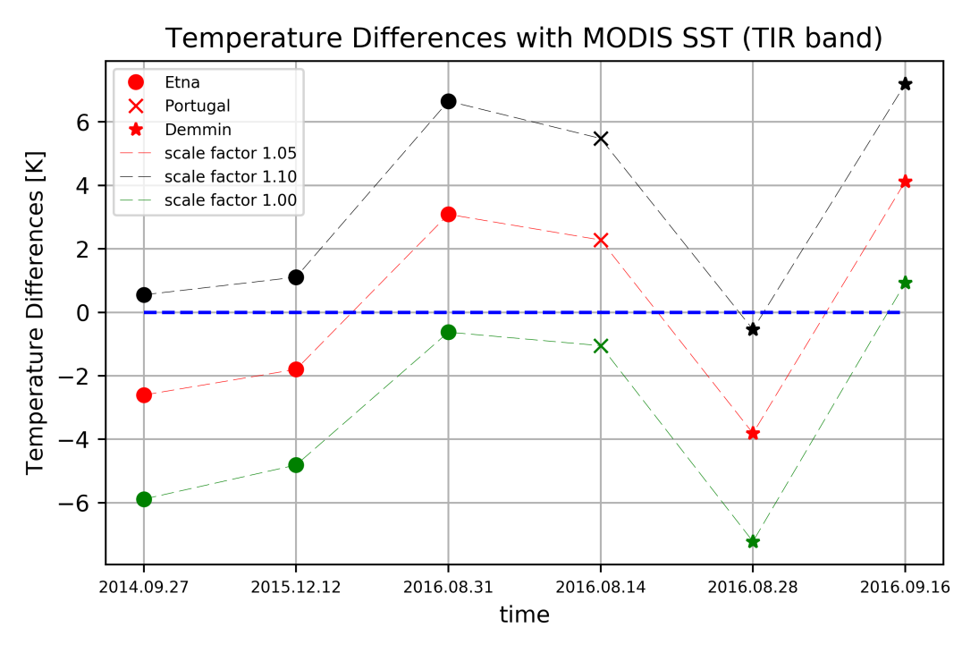
2.2 Transferability test (SST)
The chosen scale factor should be tested with different TET-1 imageries. Here, it is tested using scenes of Etna, Demmin and Portugal as showed bellow.

Slide 15
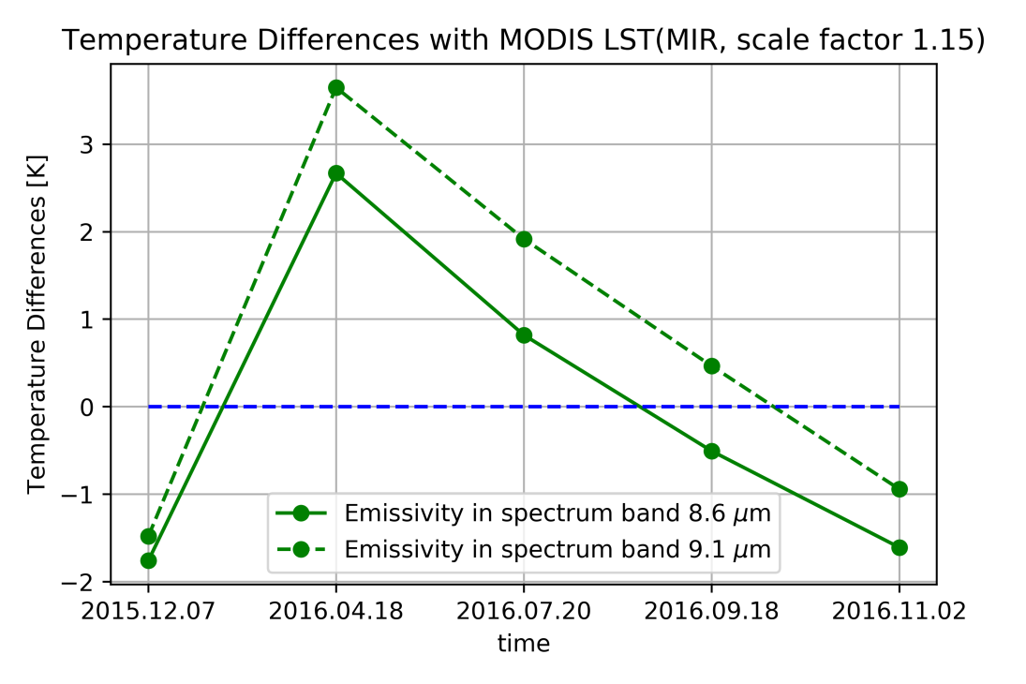
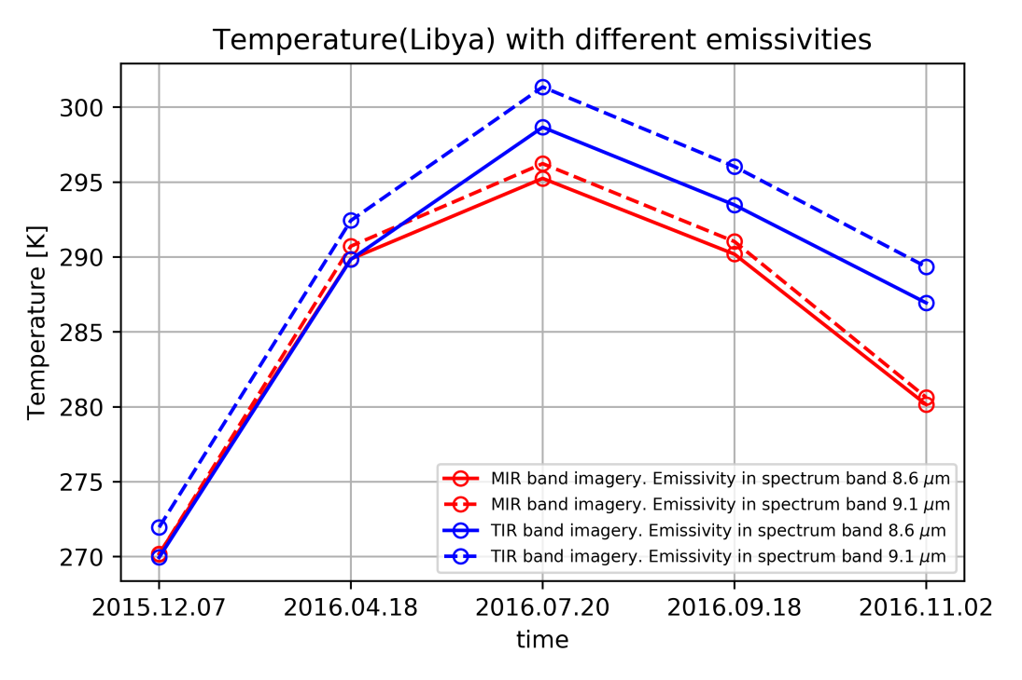
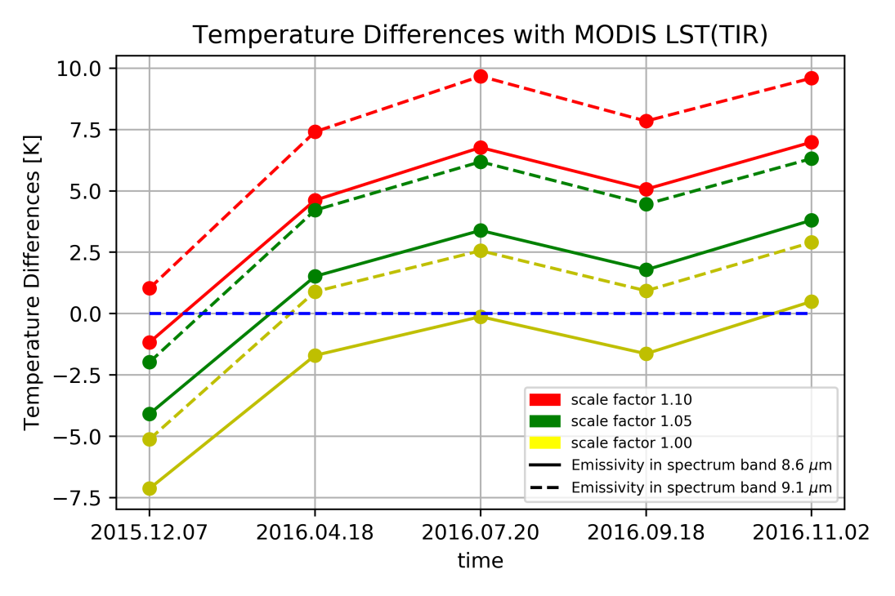
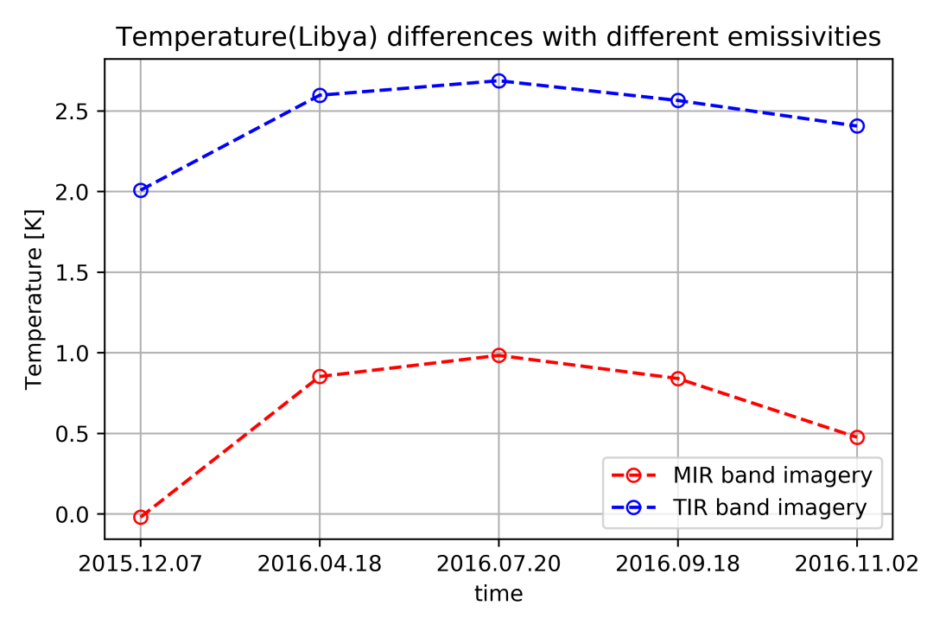
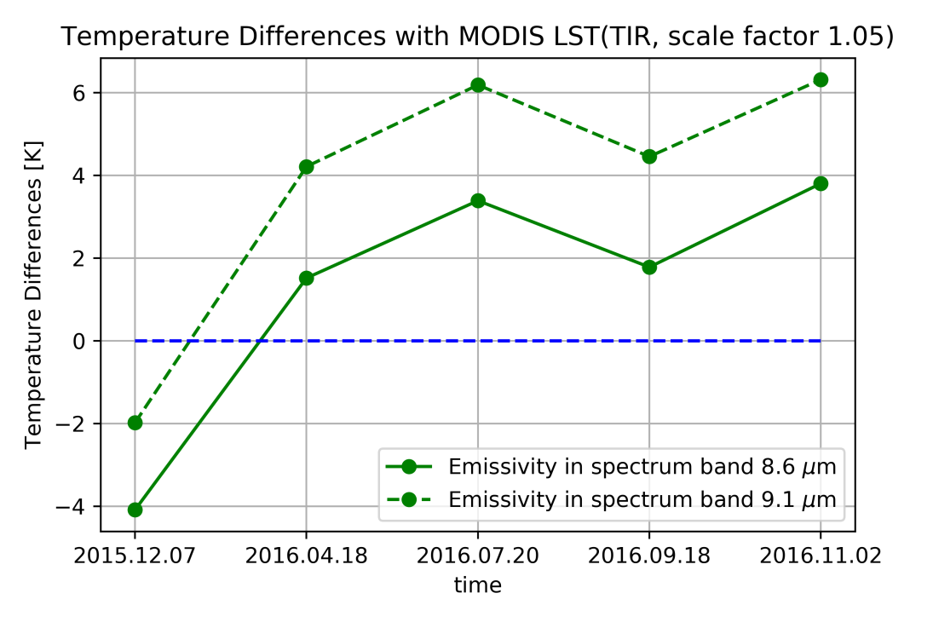
2.3 Results comparison with MODIS LST and calibration
The similar comparison is done between the temperature results from MITIP is compared with MODIS LST using scenes of Lybia-1.
However, emissivities of different land features vary a lo. So firstly we need to choose which emissvity map should be used.
With the experiences of the comparison with MODIS SST, here scale factors 1.15 for MIR band and 1.05 for TIR band are used as standard without affecting the results.

Slide 16
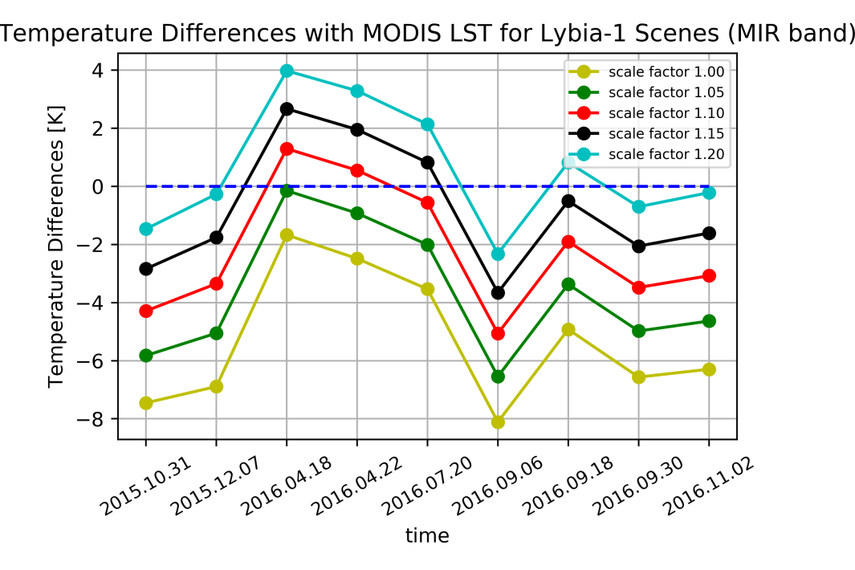
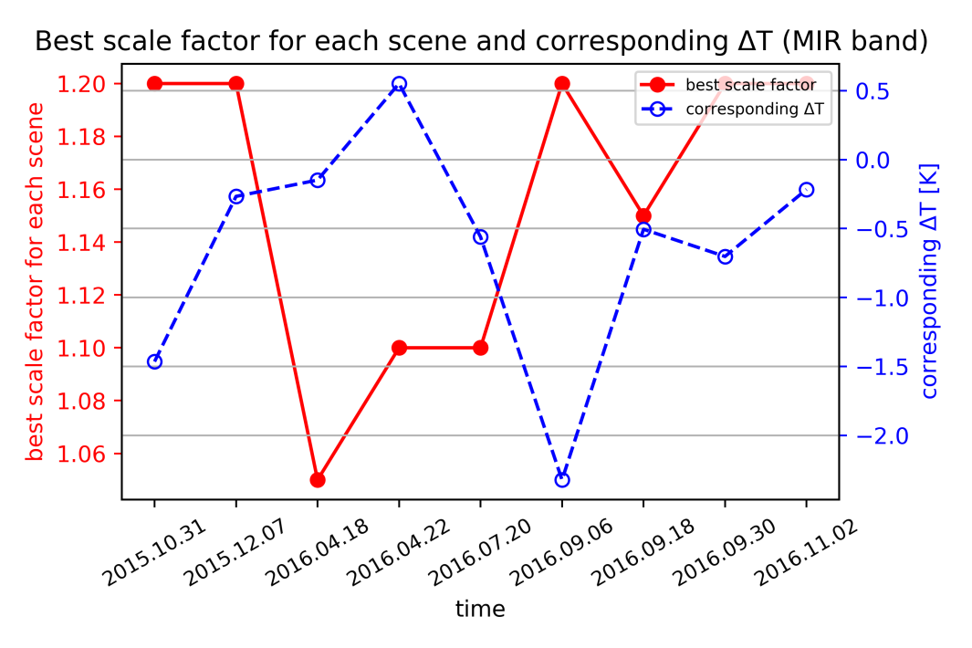
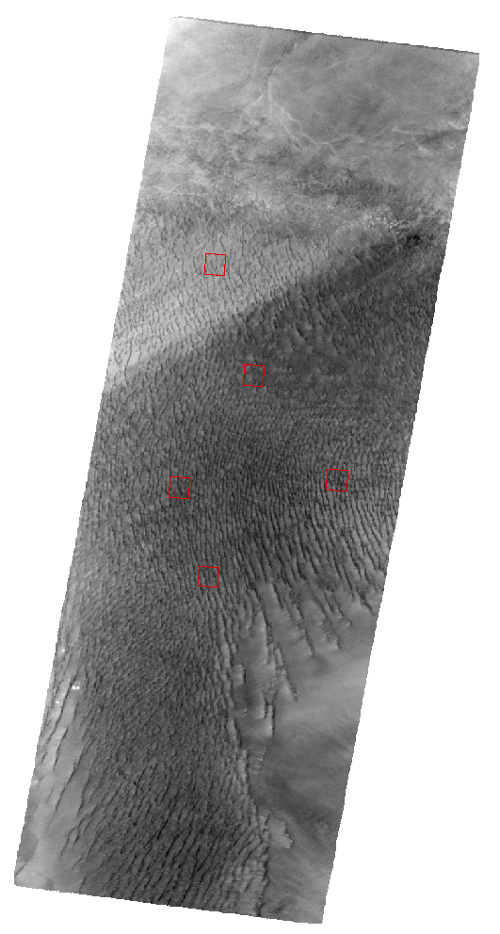
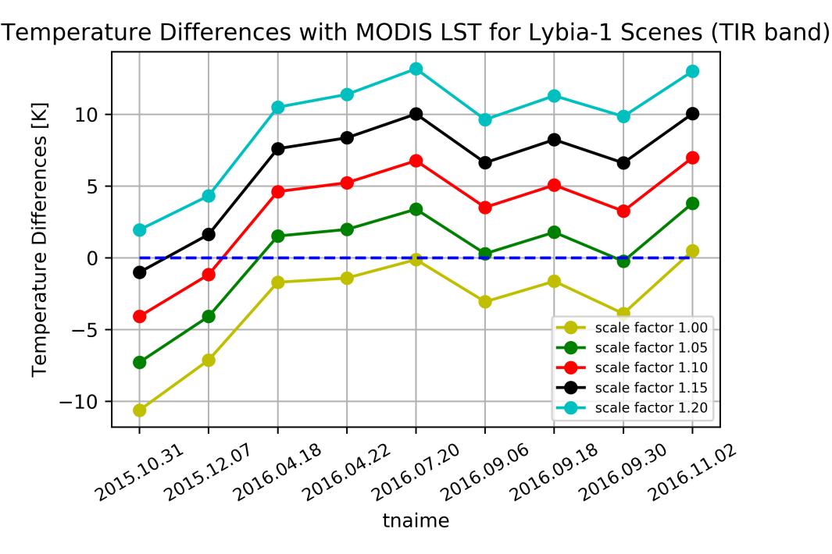
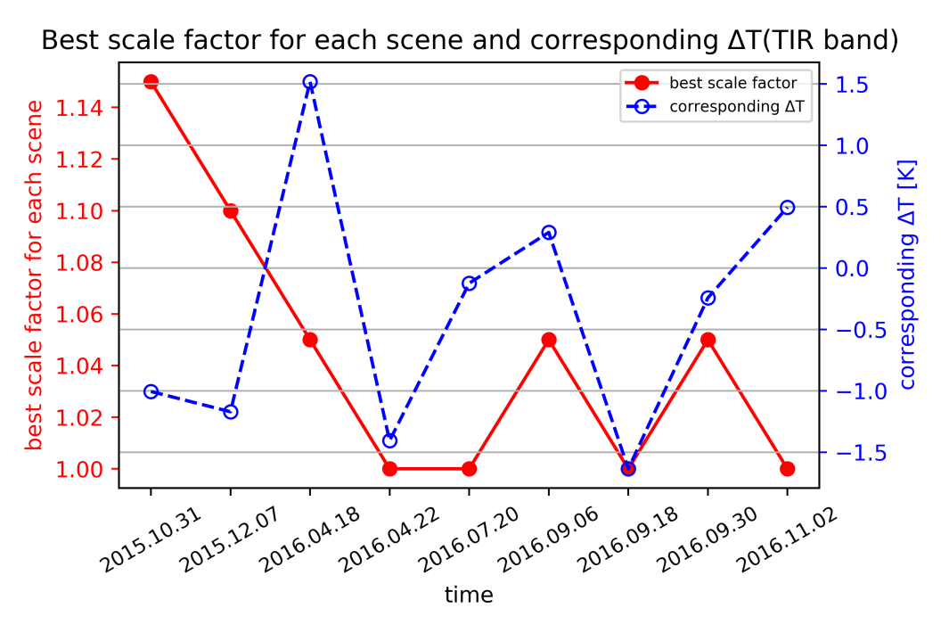
2.3 Results comparison with MODIS LST and calibration
Similarly, 5 sub-areas are chosen to do the comparison as showed in the picture on the right.
And different scale factors (1.00, 1.05, 1.10, 1.15, 1.20) are used to see the differences between the temperature results from MITIP is compared with MODIS LST. The results are showed on the right.

Slide 17
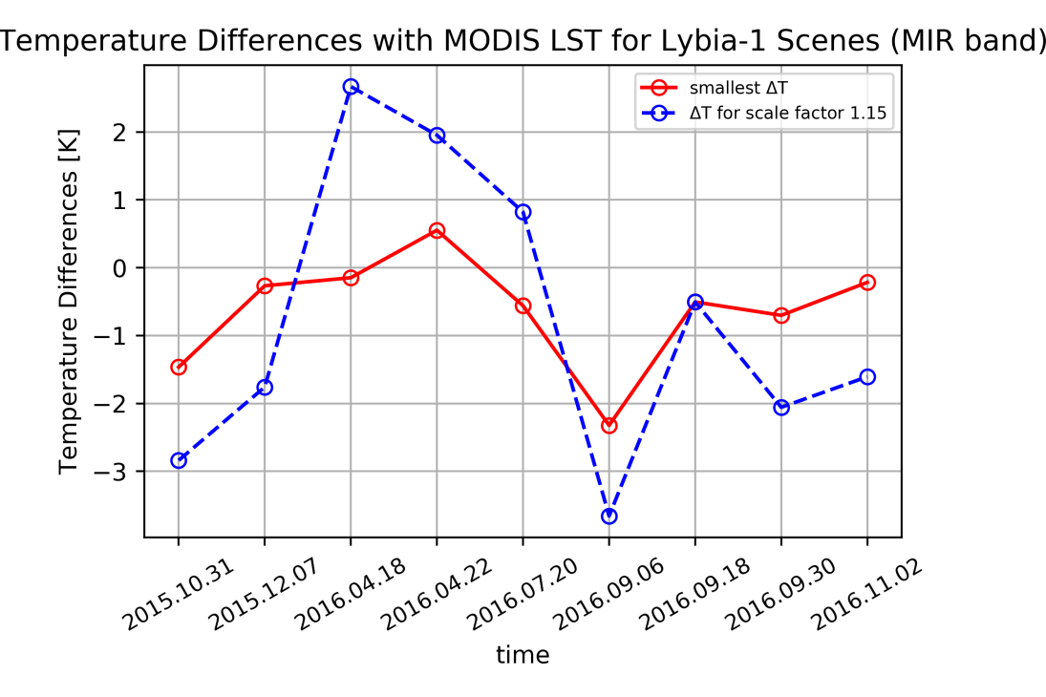


2.3 Results comparison with MODIS LST and calibration
We can see that this situation is very similar with the comparison with the MODIS SST. The optimal scale factor for each band and its corresponding temperature difference $∆T$ is showed below.
According to the comparison results and to keep consistence, the optimal scale factor for MIR band is chosen as 1.15 and for TIR band it is 1.05 as well.

Slide 18





2.4 Transferability test (LST)
The chosen scale factor would be tested with different TET-1 imageries. Here, it is tested using scenes of Libya-2.

Slide 19
3. Analysis of high-temperature events
After the analysis of the performances of MITIP under the normal-temperature environments and the improvement of it, we get optimal scale factor for MIR band and TIR band respectively.
Now, we are able to analyse the performances of MITIP on the monitoring of high-temperature events (HTE).

Slide 20




3.1 High-temperature events
Etna 2014.06.22

Slide 21
3.1 High-temperature events
Etna 2014.06.22

